Slide 1
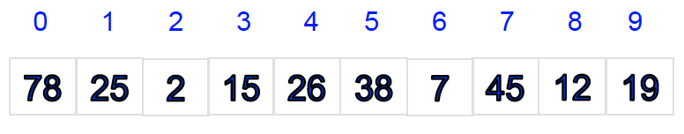
Consider an unsorted list of integers. How would we determine if a given integer, say 19, is in the list?
This problem is called “sequential search” or “linear search.”

Slide 2
Sequential Search
How to design an algorithm to solve this problem?
How would we analyze this algorithm?

Slide 3
How would we analyze this algorithm mathematically?
Time, space, hardware, power, other algorithms. Focus on the running time
= how long it takes to find an arbitrary member of the list.
= How many “basic operations” (e.g., comparing one integer to another) does it take to find the integer (or not),
expressed as a function of N = number of data items.
In the worst case? In the best case? In the average case?

Slide 4
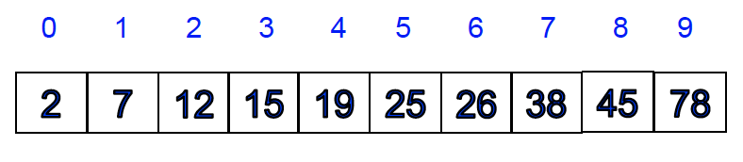
Consider when we sort the list into ascending order:
The best way to do this is called “binary search.”

Slide 5
How would we analyze these algorithms experimentally?
Again, we want to count the number of “basic operations” such as comparisons, but in this case we will run the program with sample data (randomly generated lists) and actually count the number of comparisons.
Hopefully, our mathematical and experimental results are consistent!!

Slide 6
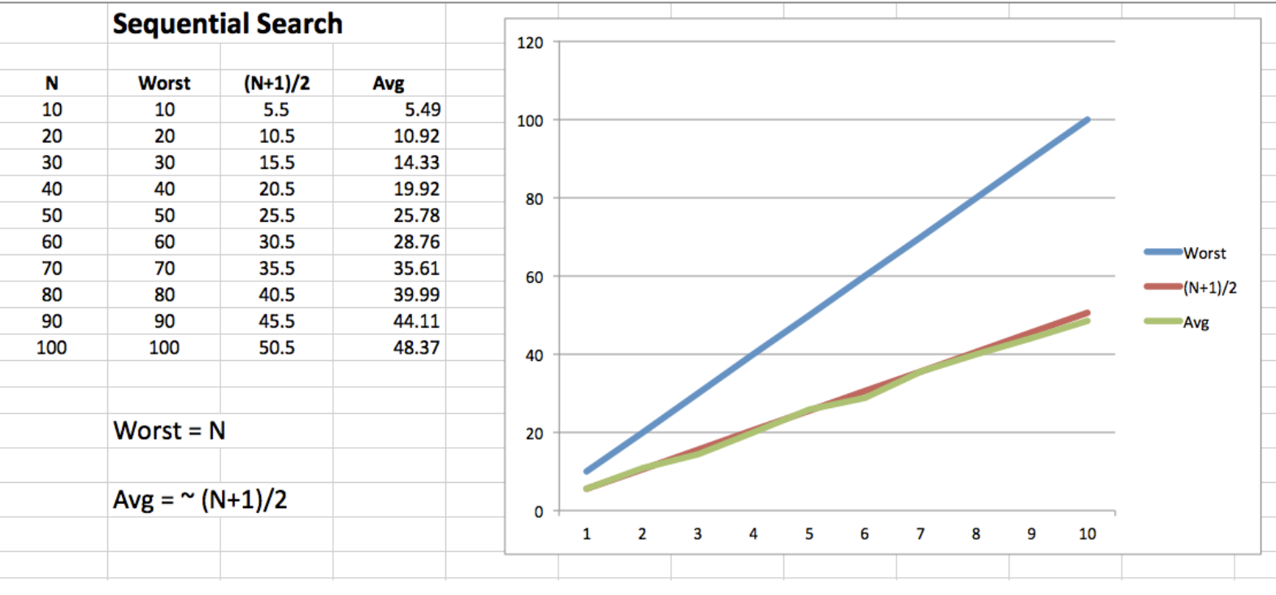
Experiments with Sequential Search

Slide 7
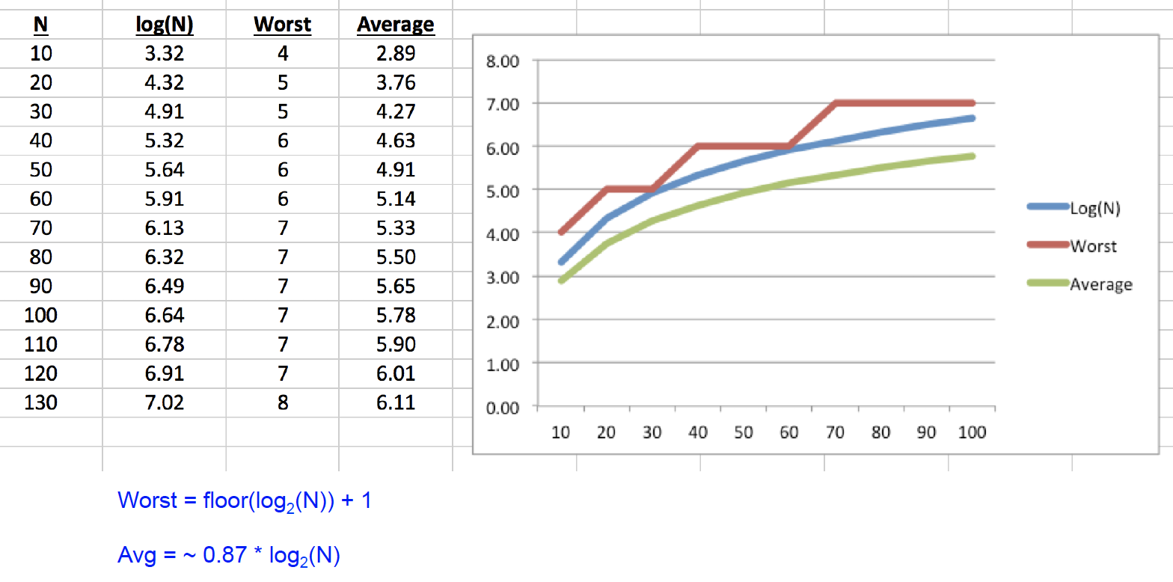
Experiments with Binary Search

Slide 8
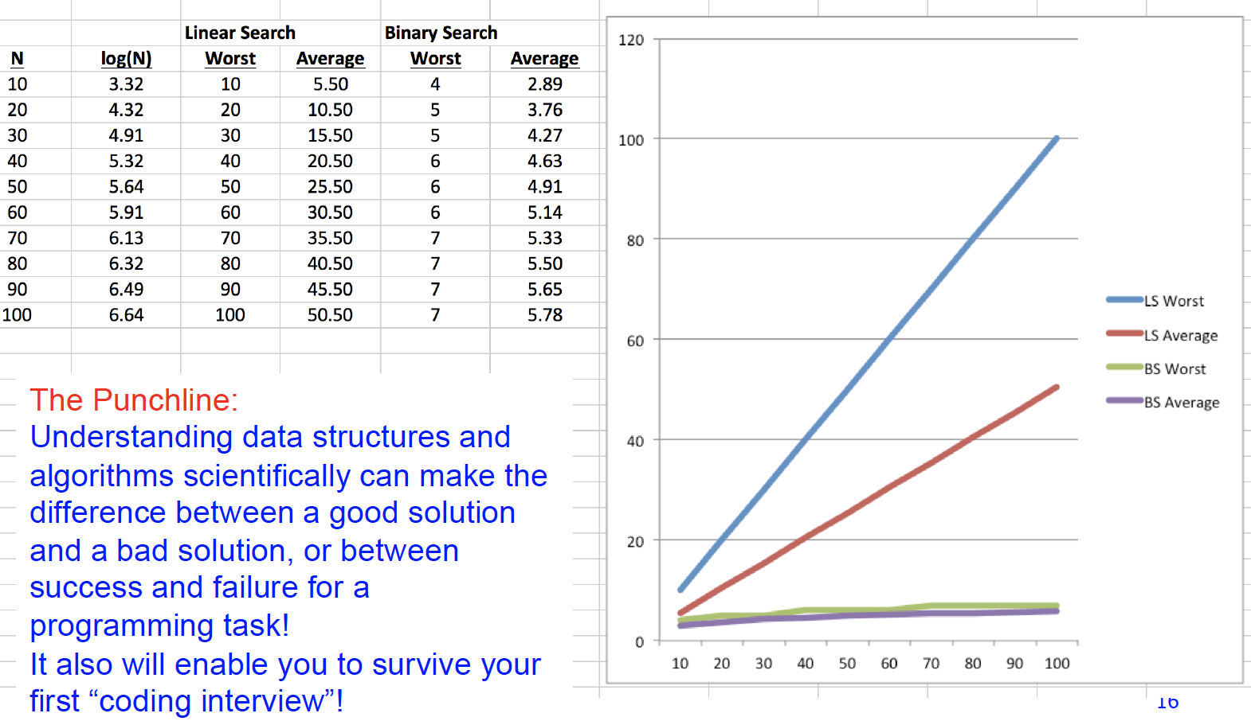
Comparison

Slide 9
Your experiences of using data structures or algorithms in real-world scenarios?

